Slide 1

Enhancing Workplace Wellness A Data-driven Approach to Employee Health
Presented by:
Balaji Bet
PGA – 36
Imarticus Learning, Pune

Slide 2

Understanding the Problem Statement
Understanding the Problem Statement
Company: XYZ Technical Solutions
Situation: Lost an important employee
Concern: Deeply concerned about the health and well-being of remaining employees
Responsibility: Developing a predictive model
Objective: Identify employees who require medical treatment
Goal: Understand factors affecting employee health and well- being and design targeted wellness programs
Purpose: Improve employee health and productivity

Slide 3


Understanding the Problem Statement
Company :- XYZ Technical Solutions
Situation :- Lost an important employee
Concern :- Deeply concerned about the health and well-being of remaining employees
Responsibility:- Developing a predictive model
Objective :- Identify employees who require medical treatment
Goal :- Understand factors affecting employee health and well- being and design targeted wellness programs
Purpose :- Improve employee health and productivity

Slide 4

Agenda
Evaluation & Tunning
Insights
Descriptive Analysis
Step Included
Applying ML algorithms
data cleaning and encoding
What Companies Can Achieve
Data Pre-processing
optimize the hyperparameters
challenges
EDA
Model Building

Slide 5
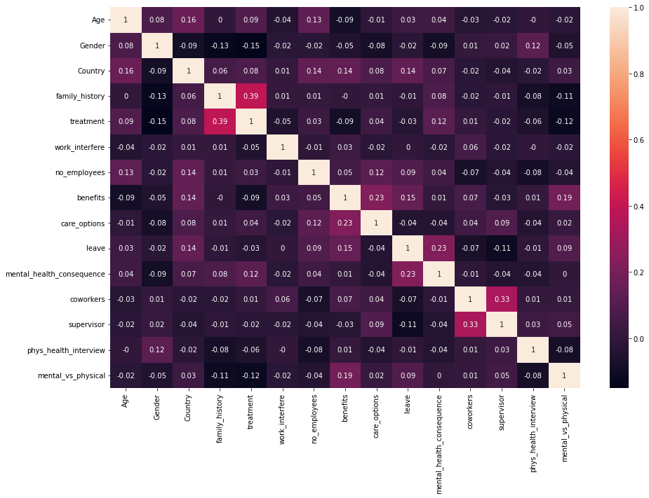
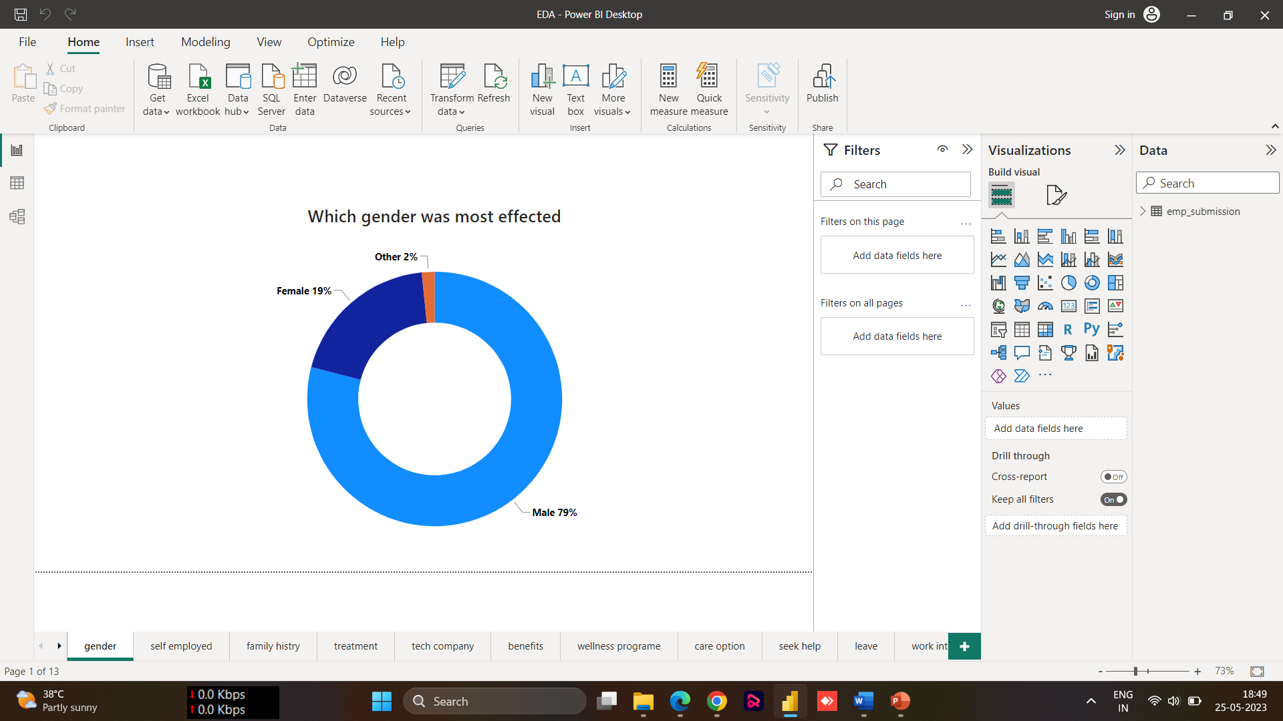
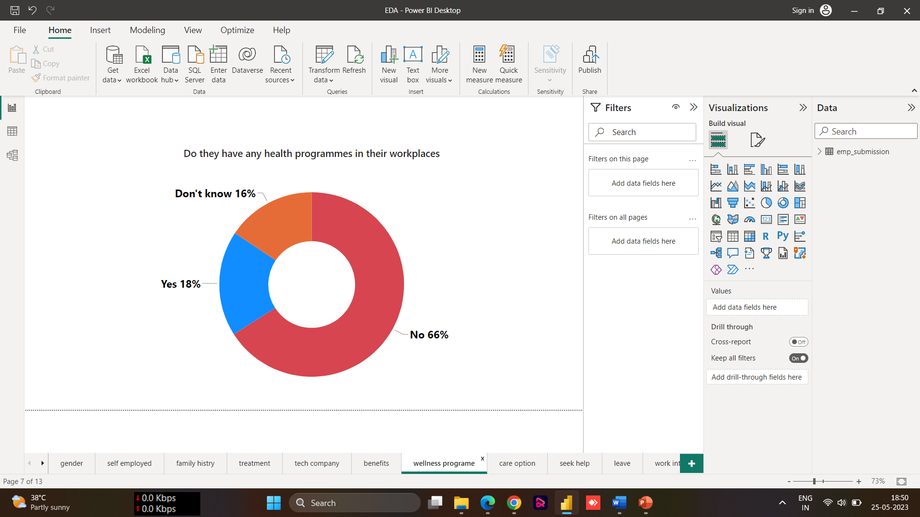
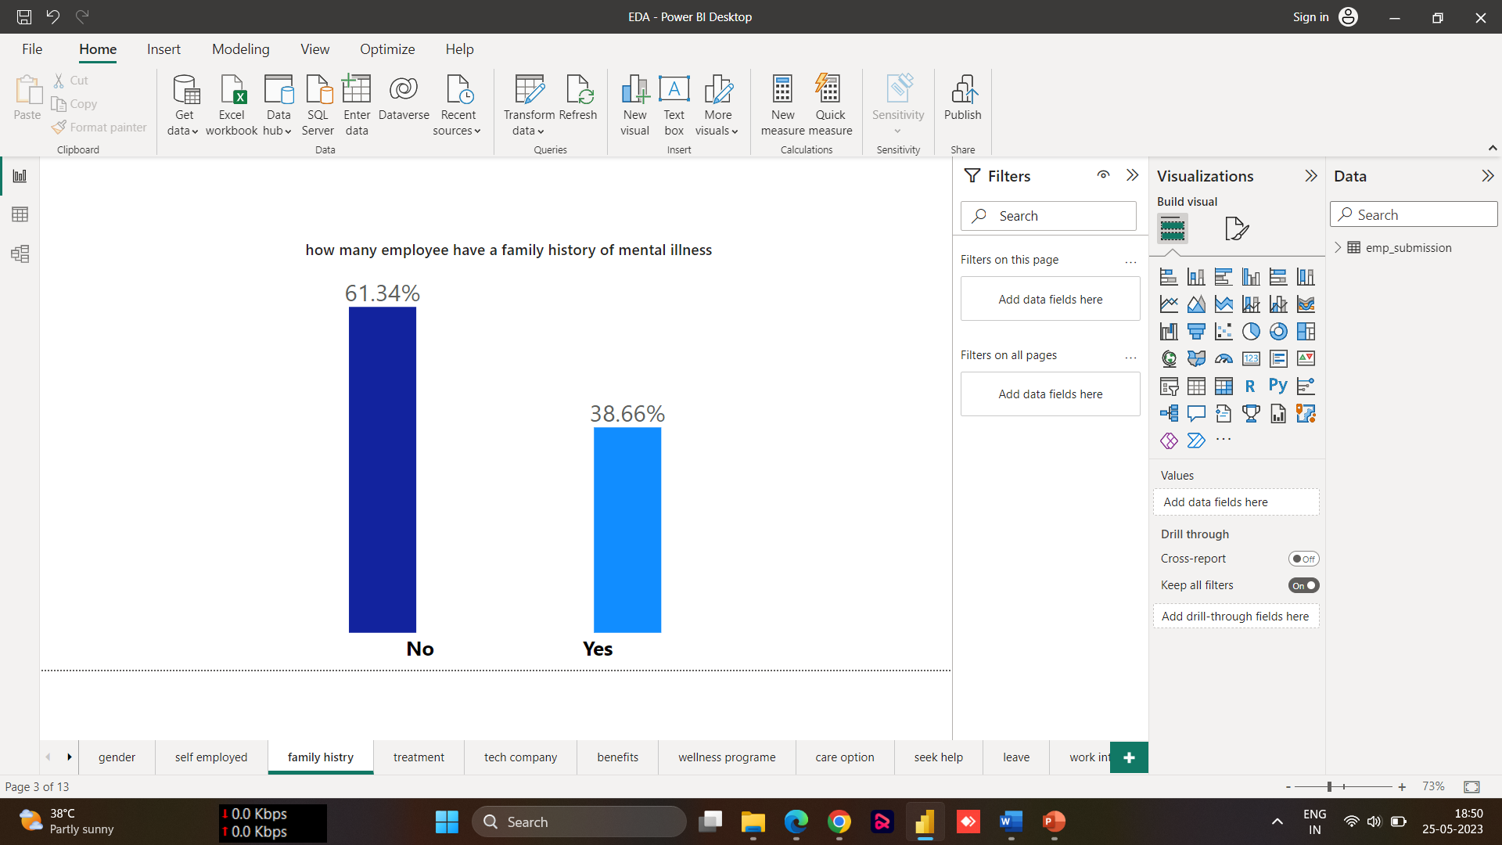
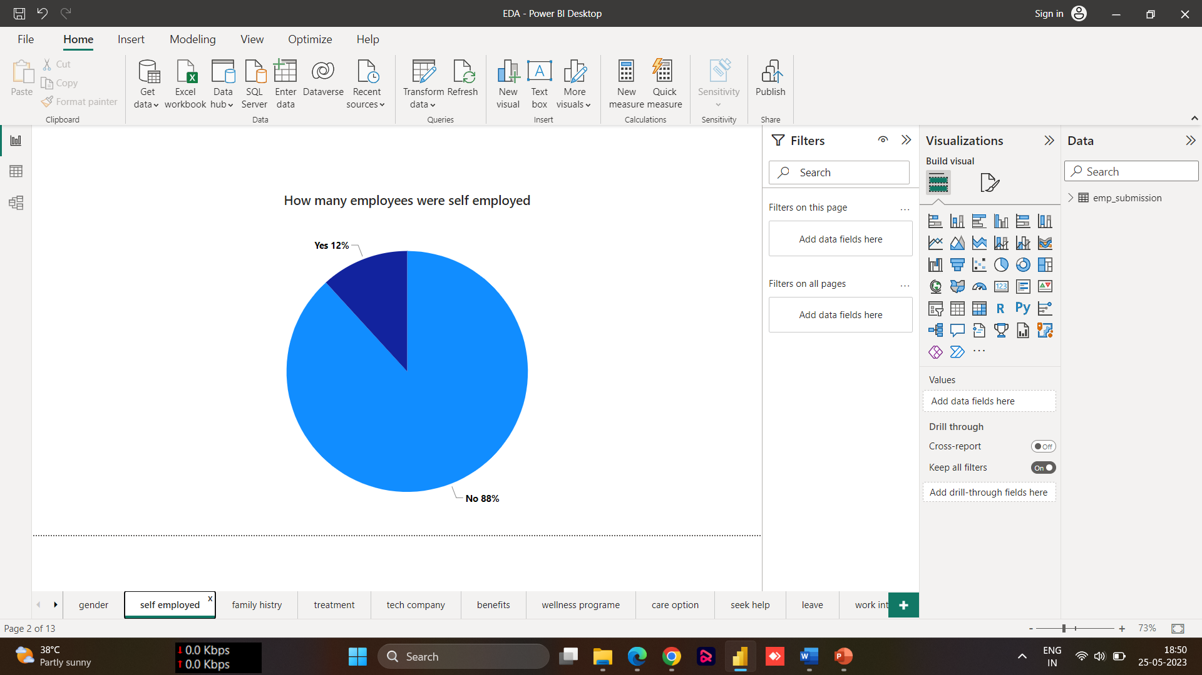
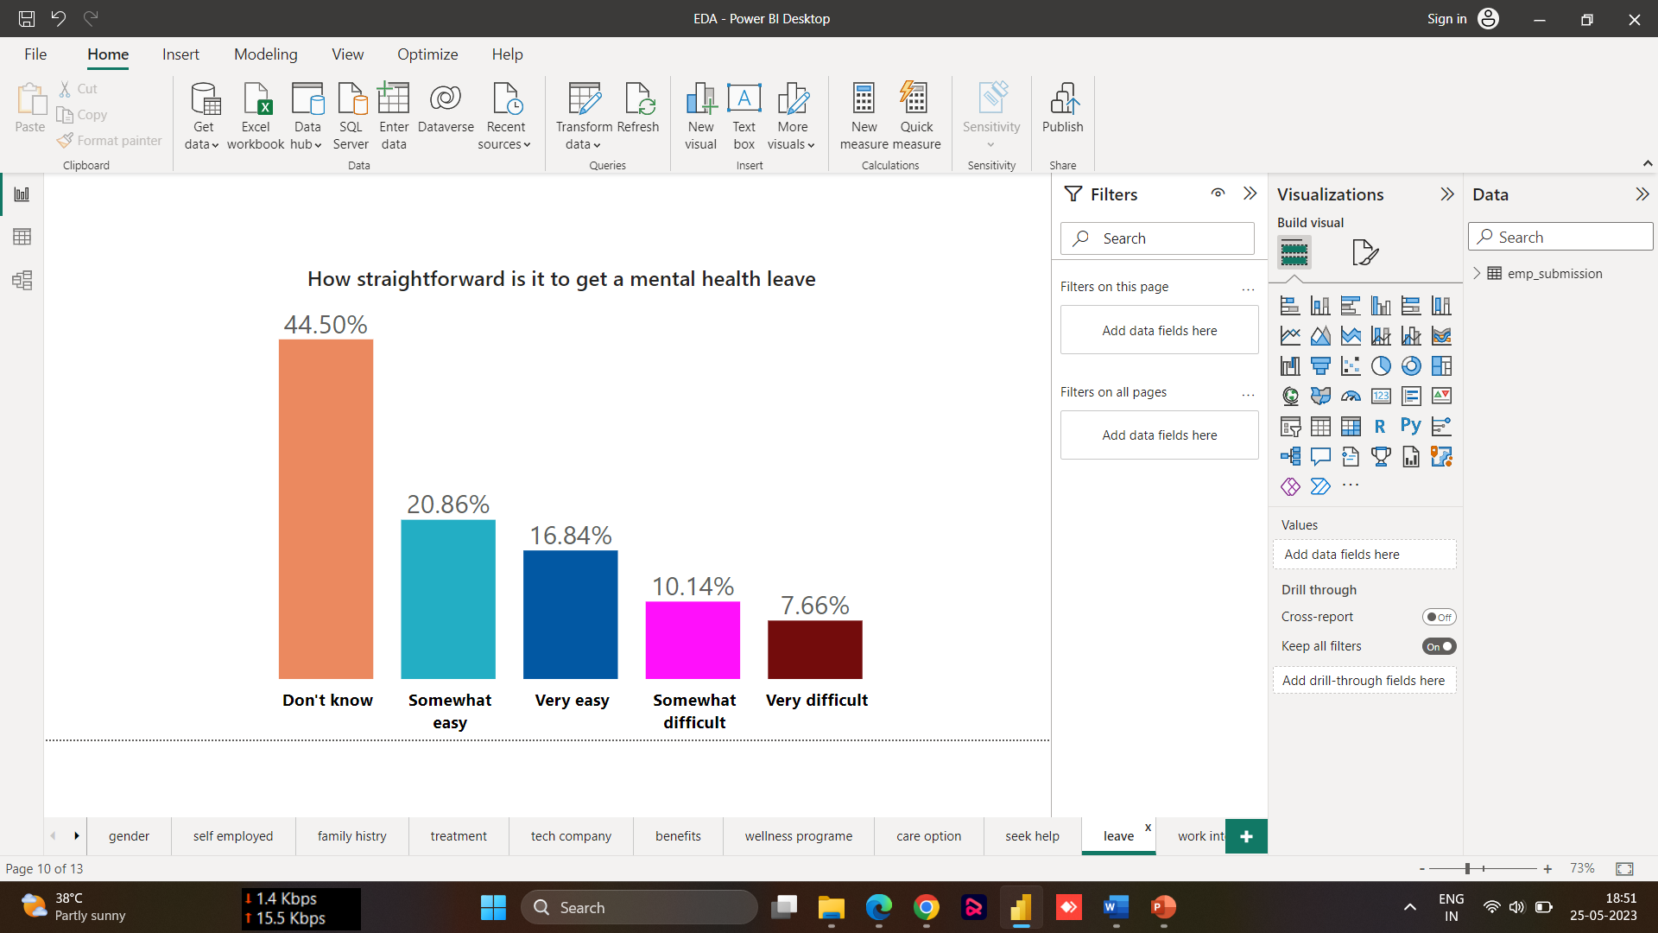
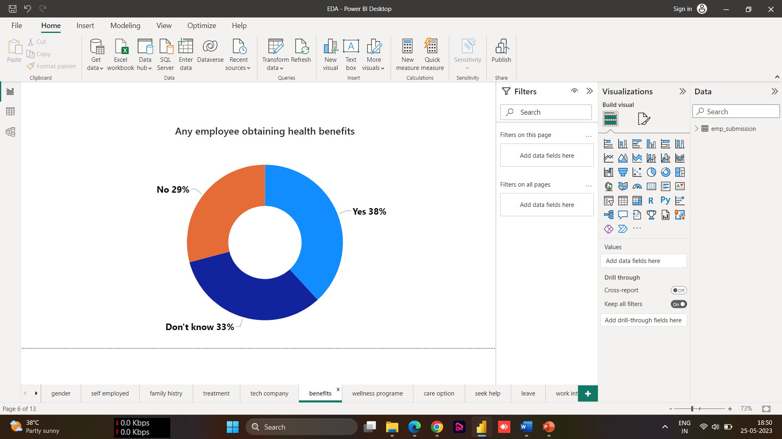
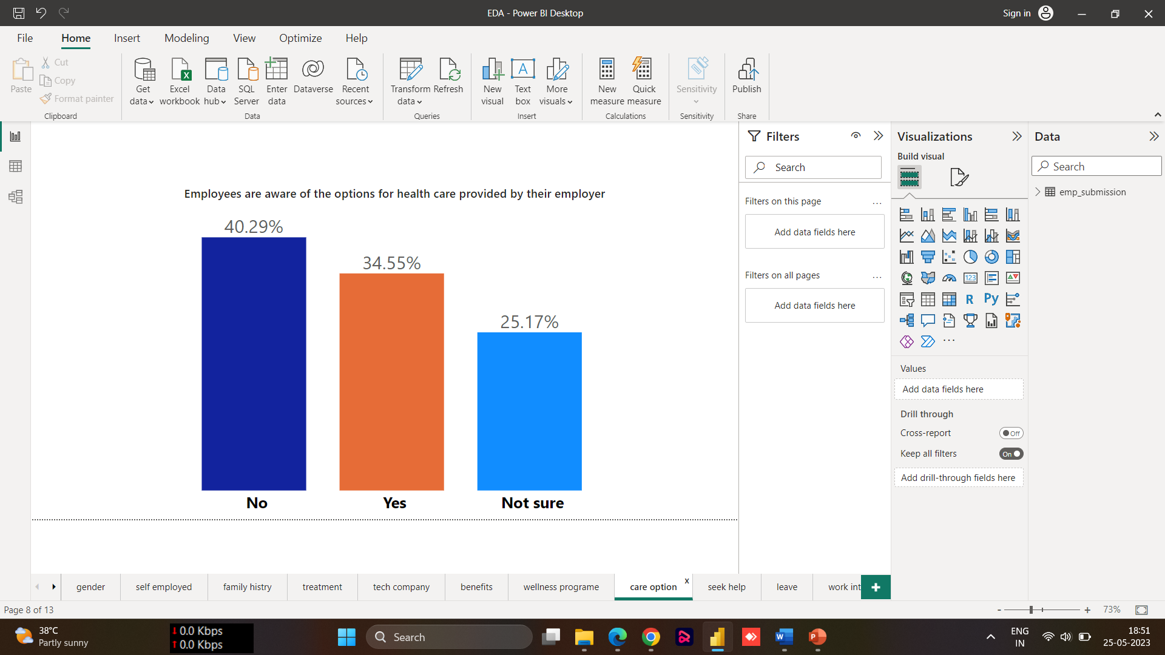
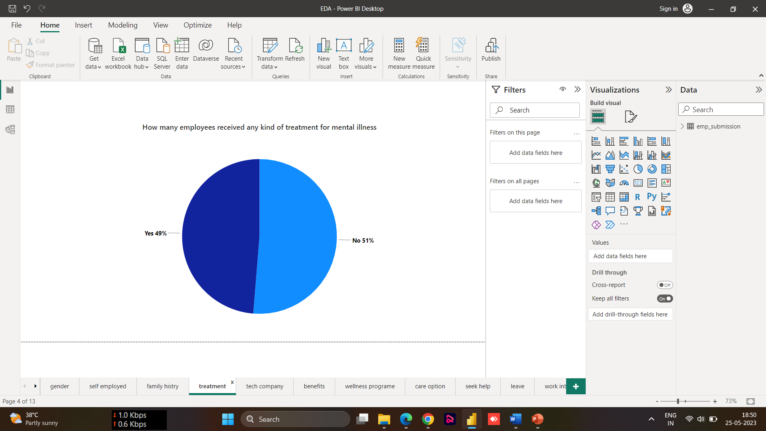
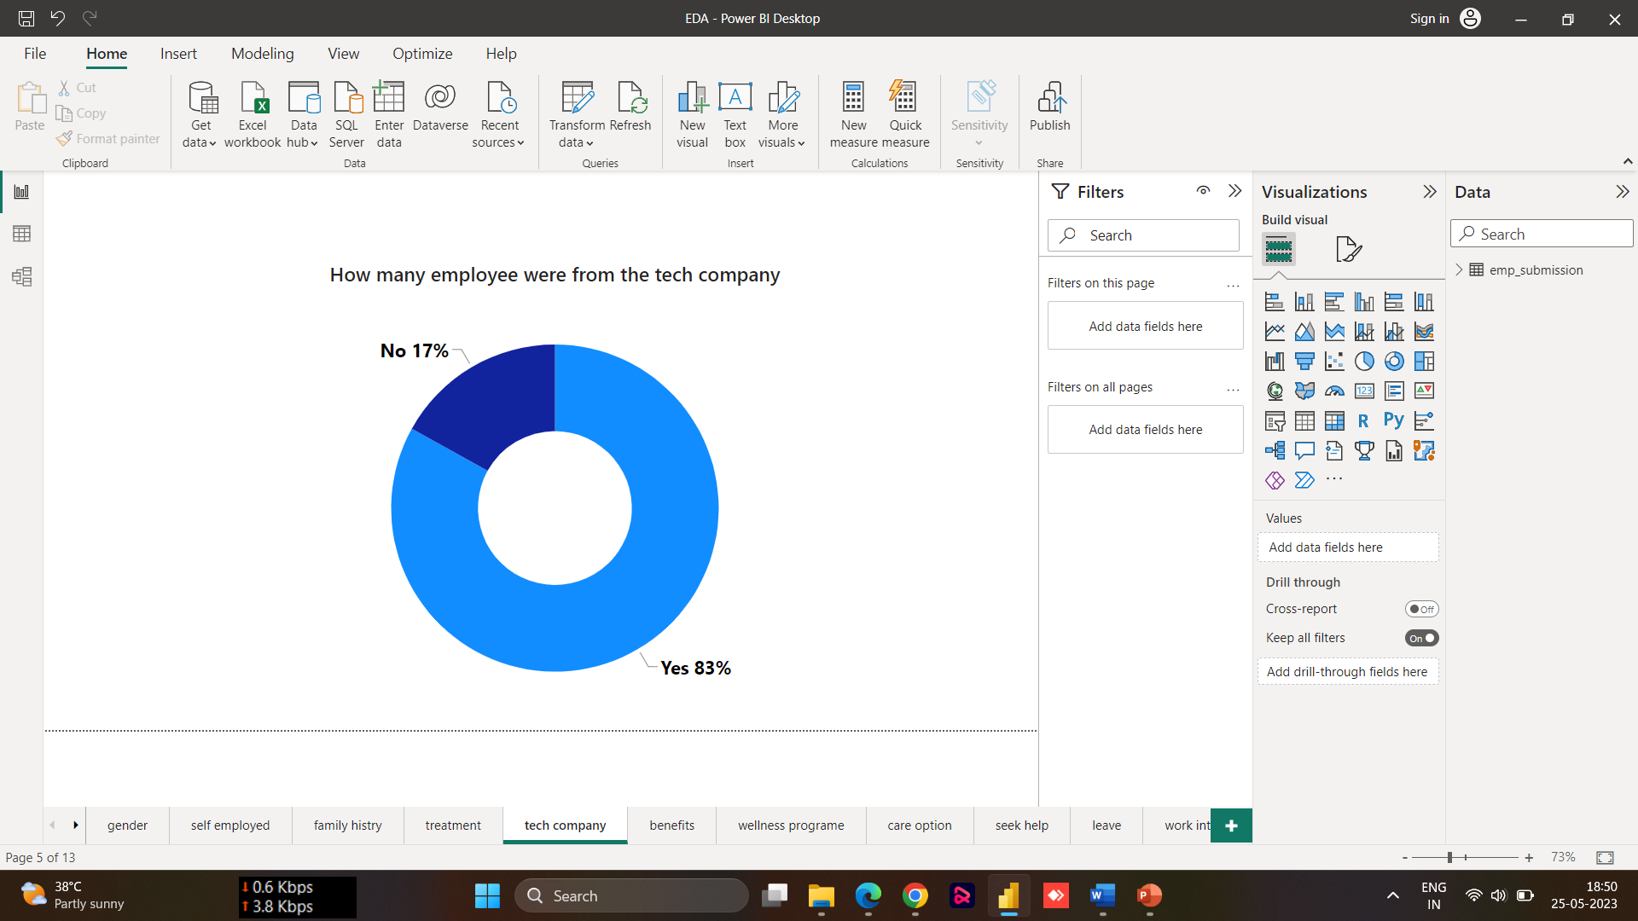
EDA – Data Visualization

Slide 6

Step Involved For
Model Building
Data
Pre-processing
Feature engineering
Model selection and training
Evaluation and comparison

Slide 7

Model Building
Logistic Regression
Decision Tree
Random Forest
K-nearest Neighbours (KNN)
Support Vector Machines (SVM)
AdaBoost

Slide 8

Evaluation and tunning
Models (before Feature Selection & Tunning) | Accuracy | F1 Score
Logistic Regression | 73.33 | 71.13
Decision Tree | 73.33 | 70.83
Random Forest | 80.95 | 80.19
K-nearest Neighbours (KNN) | 60.95 | 60.57
Support Vector Machines (SVM) | 75.23 | 75.00
AdaBoost | 79.52 | 78.81
Models (After Feature Selection & Tunning) | Accuracy | F1 Score
Logistic Regression | 73.33 | 72.54
Decision Tree (Tunning) | 85.71 | 86.36
Random Forest (Tunning) | 87.14 | 87.89
K-nearest Neighbours (KNN) | 76.66 | 76.99
Support Vector Machines (SVM) (Tunning) | 76.19 | 75.72
AdaBoost | 80.95 | 81.13
RandomForestClassifier(criterion= 'entropy', max_depth= 7, n_estimators= 116)
To evaluate the models, I used metrics such as accuracy, and F1-score. After evaluating the initial performance, I performed model tuning to optimize the hyperparameters, like max_depth, max_leafnode, n_estimators, criterion, kernels Techniques like GridSearchCv and Optuna helped me fine-tune the models and achieve better results.

Slide 9


Best model
justification and
conclusion
Conclusion: Random forest model effectively identified employees requiring treatment, improving their well-being.
Best model: Random forest
algorithm outperformed
others.
Justification: Higher accuracy and F1 score in identifying employees needing treatment.
Random forest's strength: Handling complex patterns and avoiding overfitting.

Slide 10
Best model
justification and
conclusion
Conclusion: Random forest model effectively identified employees requiring treatment, improving their well-being.
Best model: Random forest
algorithm outperformed
others.
Justification: Higher accuracy and F1 score in identifying employees needing treatment.
Random forest's strength: Handling complex patterns and avoiding overfitting.

Slide 11
Best model
justification and
conclusion
Conclusion: Random forest model effectively identified employees requiring treatment, improving their well-being.
Best model: Random forest
algorithm outperformed
others.
Justification: Higher accuracy and F1 score in identifying employees needing treatment.
Random forest's strength: Handling complex patterns and avoiding overfitting.

Slide 12
Best model
justification and
conclusion
Conclusion: Random forest model effectively identified employees requiring treatment, improving their well-being.
Best model: Random forest
algorithm outperformed
others.
Justification: Higher accuracy and F1 score in identifying employees needing treatment.
Random forest's strength: Handling complex patterns and avoiding overfitting.

Slide 13
Challenges faced
Hyperparameter tuning: Required substantial resources and time.
Overcoming challenges: Implemented effective techniques for data cleaning and encoding.
Successful solution delivery.
Challenges: Data cleaning and encoding posed difficulties.
Data cleaning: Handling missing values and outliers.
Encoding: Representing categorical features numerically.

Slide 14

Challenges faced
Challenges: Data cleaning and encoding posed difficulties.
Data cleaning: Handling missing values and outliers.
Encoding: Representing categorical features numerically.
Hyperparameter tuning: Required substantial resources and time.
Overcoming challenges: Implemented effective techniques for data cleaning and encoding.
Successful solution delivery.

Slide 15
Business insights
Business insights: Identifying employees in need of treatment.
Proactive approach: Targeted programs for employee well-being.
Creating a healthier work environment.
Increased productivity through employee support.
Decreased absenteeism and improved job satisfaction.
Positive work atmosphere.
Thank You

